Slide 1
Memory Management with ARC

Slide 2
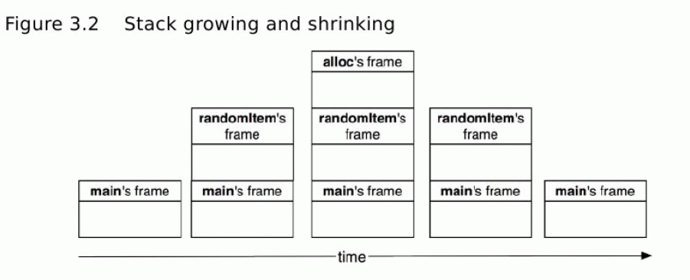
The Call Stack
Holds function calls and their associated program code
Also holds local variables and non-dynamic variables
  E.g., int myVar = 0; // this would live on the stack
The amount of memory required is already known
  Add up the sizes of all the code and variables
Changes size as program progresses (F.I.L.O.)

Slide 3
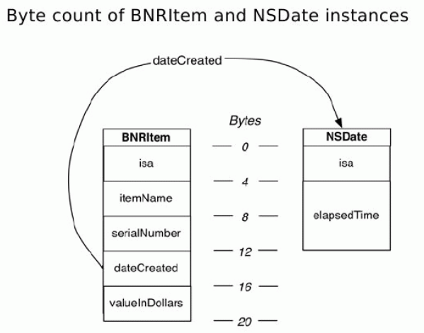
The Heap
Holds objects
  dynamic variables, memory allocated at run-time
Example: create a BNRItem
  alloc: create memory for 1 int and 5 pointers
  Pointers to properties and other dynamic objects
When is memory from the Heap removed?
  “ownership”

Slide 4
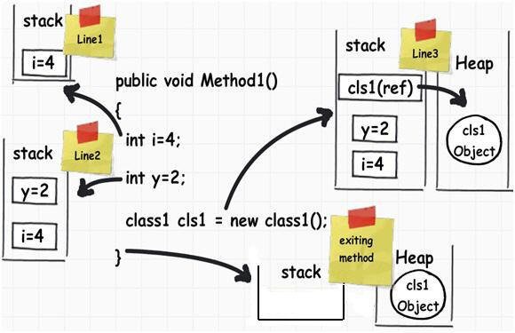
The Stack & Heap
Notes:
Nothing on the stack until Method1 executes
Local variables added to the stack
A pointer to the heap
Leaking memory
In C++ use delete[]
In Objective-C they give Automatic Reference Counting

Slide 5
Automatic Reference Counting
What about in the case where two pointers to cls1 exist?
  E.g.: Pass cls1 by reference; now new instance has a pointer
Manually count all references to cls1 in the heap, and only allow it to be destroyed once no other pointers exist
With ARC, the language manages your pointers for you
  Any object with no owners will be destroyed (by garbage collection)
  Any object with >0 owners will not be destroyed (no dangling pointers, or pointers to destroyed memory)

Slide 6
Ownership
How to gain ownership of an object
  Create the object, or pass by reference
  Example: NSArrays own each Object in the array since each element is a pointer, and not a contiguous chunk of memory
How to lose ownership of an object
  The owner decides to point to some other Object
  The owner is pointed to nil
  The owner itself is destroyed
  An object is removed from an Array or Collection

Slide 7
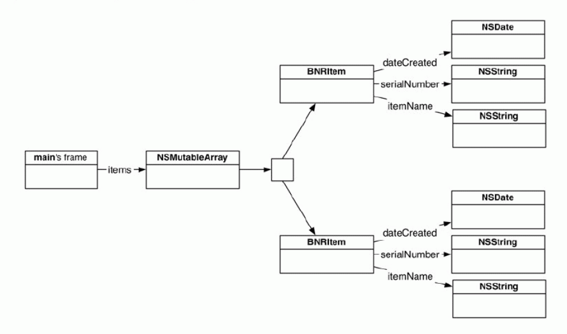
Ownership Chains
removeObjectAtIndex:0
  “An object is removed from an Array or Collection”

Slide 8
Ownership Chains
ARC--
removeObjectAtIndex:0
  “An object is removed from an Array or Collection”

Slide 9
Ownership Chains
ARC--
ARC--
removeObjectAtIndex:0
ARC--
  “The Owner itself was destroyed”

Slide 10
Strong & Weak References
These were examples of Strong references
  Adding a reference increased the ARC count (ARC++)
  Removing a reference decreased the ARC count (ARC--)
Weak references do not affect ARC count
If two Objects own each other, then they can never be destroyed
  Known as a retain cycle
One reference (normally the child to the parent) should be weak
  Ex: Strong reference Wallet====>Cash
  But Weak reference Cash - - - - >Wallet
  If Wallet is destroyed, so is Cash
  But even if Cash is destroyed, you still have your Wallet
Making “up references” weak is your responsibility

